Slide 1
THE SCIENCE OF SIN AND SALVATION
ROBERT MELASHENKO MD
Copyright Robert Melashenko 2013
All Rights Reserved

Slide 2
LECTURE NINE
The Plan of Salvation Part 2: CHRIST’S DEATH

Slide 3
REVIEW
Christ came into our world after the Adversary had introduced his varied information weaponry against humanity.
The three wilderness temptations were engineered to appeal to the three main areas that the Devil utilizes to tempt humanity into using MGE controlled brain circuitry.
Christ stated objectives in coming to this world were to destroy what the enemy had made, and in the process destroy the Adversary’s influence on this earth and destroy any sympathy for him throughout the rest of God’s creation.

Slide 4
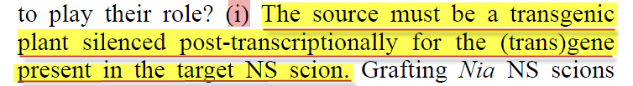
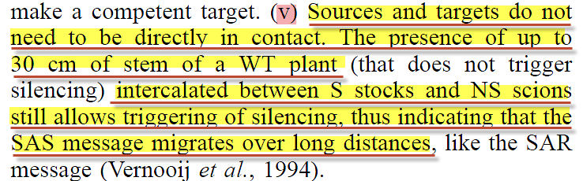
Requirements for silencing inserted gene in graft:
The EMBO Journal Vol.16 No.15 pp.4738–4745, 1997

Slide 5
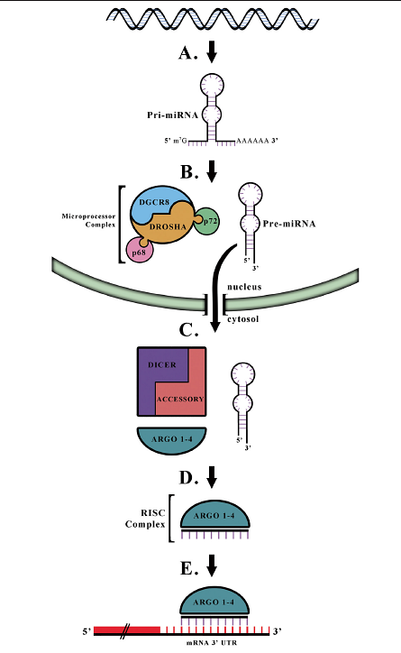
Morgan and Bale Biology of Sex Differences 2012, 3:22

Slide 6
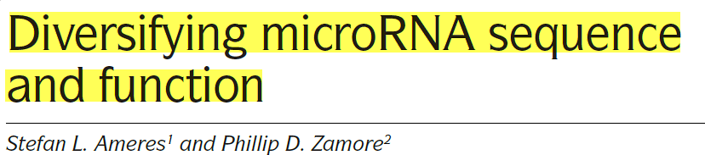
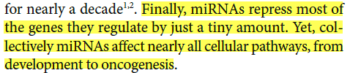
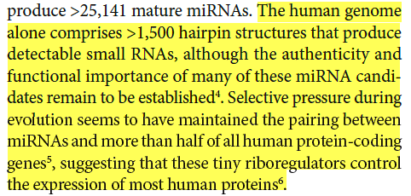
NATURE REVIEWS | MOLECULAR CELL BIOLOGY VOLUME 14 | AUGUST 2013

Slide 7
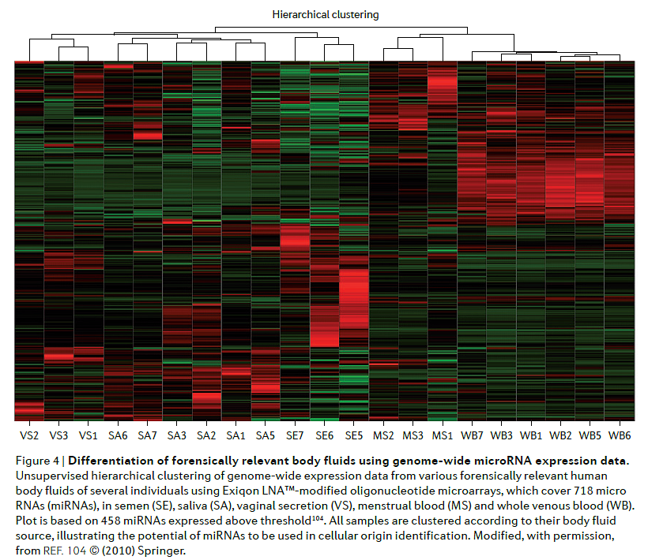
NATURE REVIEWS | GENETICS VOLUME 12 | MARCH 2011

Slide 8
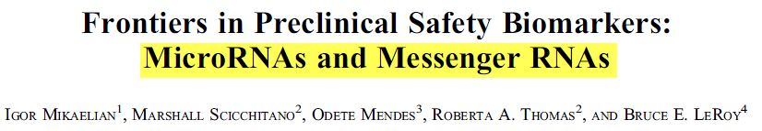

Toxicologic Pathology, 00: 1-14, 2012

Slide 9
HOW DID CHRIST OBTAIN THE miRNA’S THAT ARE ABLE TO COMBAT MGE’S AND THEIR PRODUCTS?
For it became him, for whom are all things, and by whom are all things, in bringing many sons to glory, to make the captain of their salvation perfect through sufferings. (Hebrews 2:10 AKJV)
Who in the days of his flesh, when he had offered up prayers and supplications with strong crying and tears to him that was able to save him from death, and was heard in that he feared; Though he were a Son, yet learned he obedience by the things which he suffered; And being made perfect, he became the author of eternal salvation to all them that obey him;
(Hebrews 5:7-9 AKJV)

Slide 10
But he was wounded for our transgressions, he was bruised for our iniquities: the chastisement of our peace was on him; and with his stripes we are healed.
(Isaiah 53:5 AKJV)
He shall see of the travail of his soul, and shall be satisfied: by his knowledge shall my righteous servant justify many; for he shall bear their iniquities. Therefore will I divide him a portion with the great, and he shall divide the spoil with the strong; because he has poured out his soul to death: and he was numbered with the transgressors; and he bore the sin (penalty) of many, and made intercession (hit the mark) for the transgressors.
(Isaiah 53:11-12 AKJV)

Slide 11
WHAT IS MEANT BY THE WORD “PERFECT”?
For it became him, for whom are all things, and by whom are all things, in bringing many sons to glory, to make the captain of their salvation perfect through sufferings.
(Hebrews 2:10 AKJV)
Be you therefore perfect, even as your Father which is in heaven is perfect.
(Matthew 5:48 AKJV)

Slide 12
perfect
per·fect
adjective \ˈpər-fikt\
: having no mistakes or flaws
: completely correct or accurate
: having all the qualities you want in that kind of person, situation, etc.

Slide 13
IN WHAT WAY CAN WE DO SOMETHING PERFECTLY JUST LIKE GOD?
Let no man say when he is tempted, I am tempted of God: for God cannot be tempted with evil, neither tempts he any man:
(James 1:13 AKJV)

Slide 14
The only function that we can do just like God—is not respond to evil. But this can only happen if God empowers us to do so.
I in them, and you in me, that they may be made perfect in one; and that the world may know that you have sent me, and have loved them, as you have loved me.
(John 17:23 AKJV)
Search me, O God, and know my heart: try me, and know my thoughts:
(Psalms 139:23 AKJV)

Slide 15
(For the weapons of our warfare are not carnal, but mighty through God to the pulling down of strong holds;) Casting down imaginations, and every high thing that exalts itself against the knowledge of God, and bringing into captivity every thought to the obedience of Christ;
(2 Corinthians 10:4-5 AKJV)

Slide 16
PERFECT=MATURE=NOTHING TO RESPOND TO THE DEVIL
Who in the days of his flesh, when he had offered up prayers and supplications with strong crying and tears to him that was able to save him from death, and was heard in that he feared;
Though he were a Son, yet learned he obedience by the things which he suffered; And being made perfect, he became the author of eternal salvation to all them that obey him;
(Hebrews 5:7-9 AKJV)
Hereafter I will not talk much with you: for the prince of this world comes, and has nothing in me.
(John 14:30 AKJV)

Slide 17
In whom we have redemption through his blood, even the forgiveness of sins: (Colossians 1:14 AKJV)
How much more shall the blood of Christ, who through the eternal Spirit offered himself without spot to God, purge your conscience from dead works to serve the living God? (Hebrews 9:14 AKJV)

Slide 18
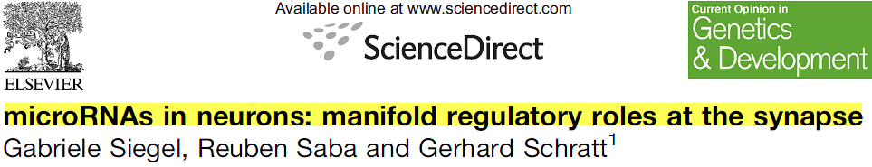
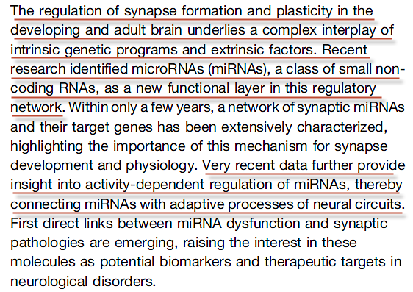
Current Opinion in Genetics & Development 2011, 21:1–7

Slide 19
But those things which proceed out of the mouth come forth from the heart; and they defile the man. For out of the heart proceed evil thoughts, murders, adulteries, fornications, thefts, false witness, blasphemies: These are the things which defile a man: but to eat with unwashed hands defiles not a man.
(Matthew 15:18-20 AKJV)

Slide 20

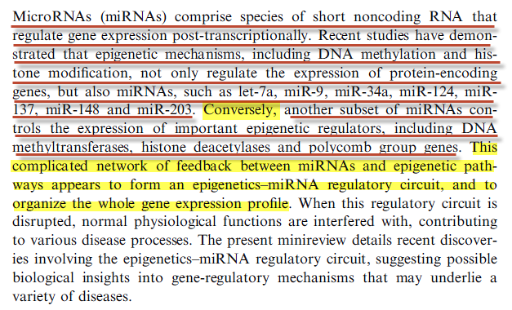
FEBS Journal 278 (2011) 1598–1609 . 2011

Slide 21
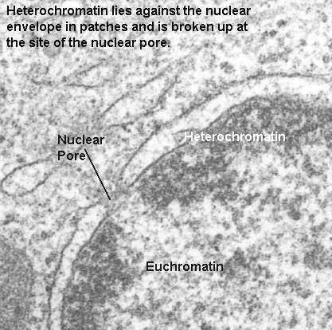
Heterochromatin

Slide 22
SUMMARY
CHRIST HAD TO TAKE OUR GENOME WITH IT’S MGE’S, OVERCOME THEIR PULL TO COMMIT CERTAIN BEHAVIORS (THOUGHTS AND/OR ACTIONS), AND MAKE miRNA’S WHICH COMBAT THE MGE’S ACTIONS.
My transgression is sealed up in a bag, and you sew up my iniquity.
(Job 14:17 AKJV)

Slide 23
For as much as you know that you were not redeemed with corruptible things, as silver and gold, from your vain conversation received by tradition from your fathers; But with the precious blood of Christ, as of a lamb without blemish and without spot:
(1 Peter 1:18-19 AKJV)
My little children, of whom I travail in birth again until Christ be formed in you,
(Galatians 4:19 AKJV)

Slide 24
WE NOW HAVE A HYPOTHESIS OF HOW HETERCHROMATIN IS FORMED.
NEXT WE NEED TO DISCUSS HOW IT MIGHT BE REMOVED.

Slide 25
CHRIST’S DEATH
WHY WAS IT NECESSARY??—OR WAS IT??
Is the law then against the promises of God? God forbid: for if there had been a law given which could have given life, truly righteousness should have been by the law.
(Galatians 3:21 AKJV)

Slide 26
HOW CAN OVER TWO-THIRDS OF OUR GENOME BE REMOVED (EVEN IF IT IS “TIED-UP” AS HETERCHROMATIN) AND HAVE US STILL BE “US”?
COULD CHRIST’S DEATH HAVE SOMETHING TO DO WITH MGE REMOVAL?
PROBLEM # 1

Slide 27
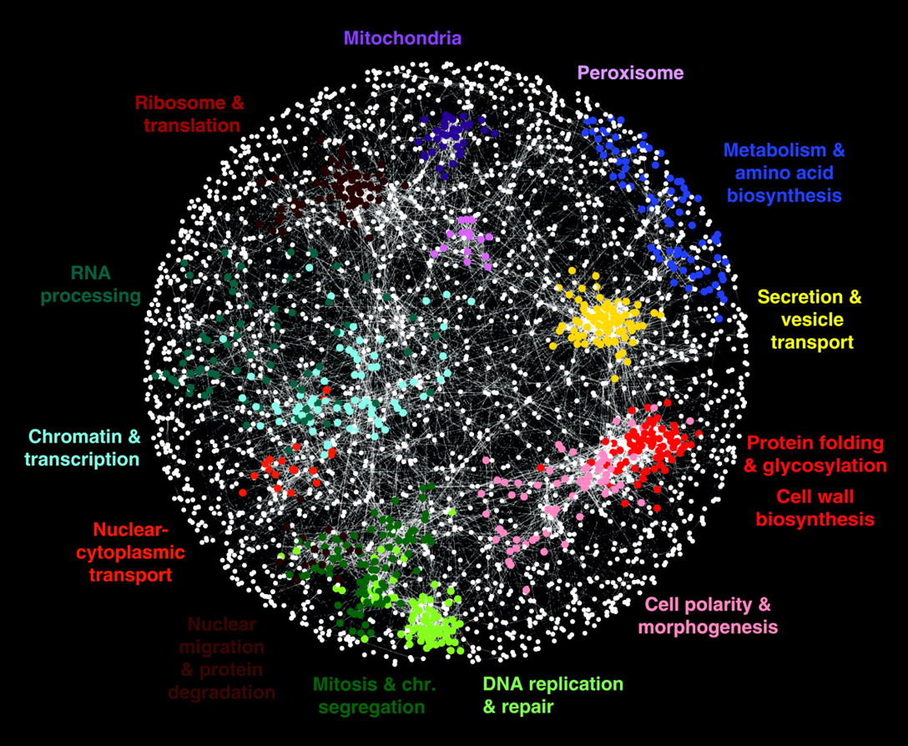

Fig. 1 A correlation-based network connecting genes with similar genetic interaction profiles.
M Costanzo et al. Science 2010;327:425-431
Published by AAAS
Notes:
A correlation-based network connecting genes with similar genetic interaction profiles. Genetic profile similarities were measured for all gene pairs by computing Pearson correlation coefficients (PCCs) from the complete genetic interaction matrix. Gene pairs whose profile similarity exceeded a PCC > 0.2 threshold were connected in the network and laid out using an edge-weighted, spring-embedded, network layout algorithm (7, 8). Genes sharing similar patterns of genetic interactions are proximal to each other; less-similar genes are positioned farther apart. Colored regions indicate sets of genes enriched for GO biological processes summarized by the indicated terms.

Slide 28
PROBLEM # 2
HOW CAN REMOVAL OF THE MGE’S NOT TRIGGER THE CELLS INTERNAL “SHUT-DOWN” PROGRAMS

Slide 29
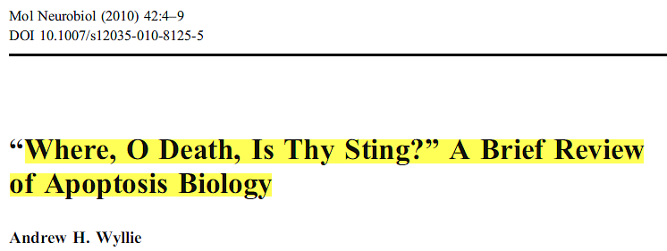
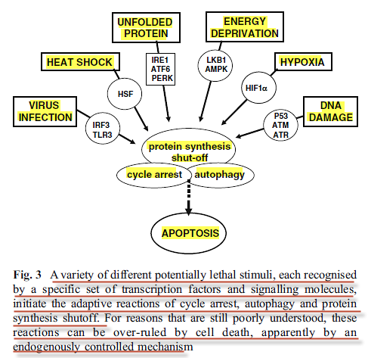
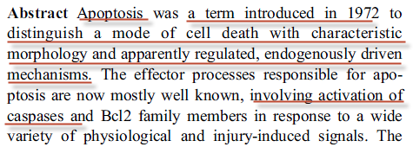

Slide 30
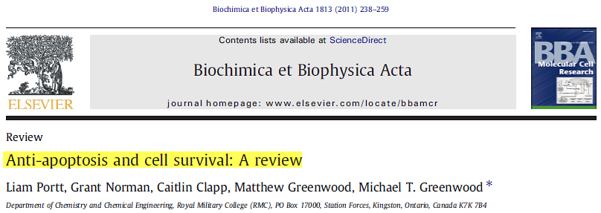
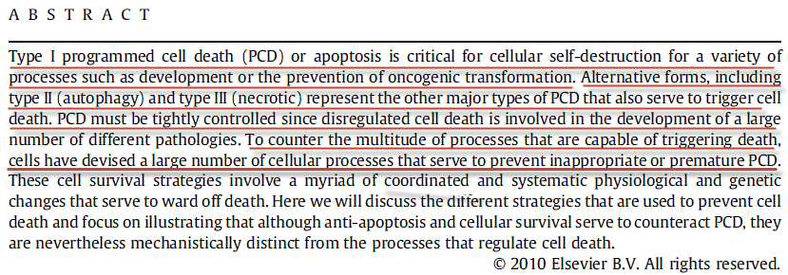

Slide 31
DOES SCRIPTURE HELP ANSWER THESE PROBLEMS?

Slide 32
And Abraham said, My son, God will provide himself a lamb for a burnt offering: so they went both of them together.
(Genesis 22:8 AKJV)
And Abraham lifted up his eyes, and looked, and behold behind him a ram caught in a thicket by his horns: and Abraham went and took the ram, and offered him up for a burnt offering in the stead of his son.
(Genesis 22:13 AKJV)

Slide 33
WE NOW NEED TO LOOK VERY CAREFULLY INTO CHRIST’S DEATH TO SEE WHAT THE BIBLE SAYS:
For the wages of sin is death; but the gift of God is eternal life through Jesus Christ our Lord.
(Romans 6:23 AKJV)
Who (Christ) was delivered (yielded up) for our offenses (missing the mark), and was raised again for our justification.
(Romans 4:25 AKJV)

Slide 34
FIRST QUESTION:
SECOND QUESTION:
WHAT HAPPENED IN GETHSEMANE? AND, WAS IT NECESSARY?
: WHY THE CROSS?

Slide 35
GETHSEMANE
For I say to you, that this that is written must yet be accomplished in me, And he was reckoned among the transgressors: for the things concerning me have an end (fulfillment). (Luke 22:37 AKJV)
"For I say to you*, it is still necessary [for] this, the [saying] having been written, to be fulfilled in Me, 'And He was counted with lawless [ones],' for also the [things] concerning Me have an end [fig., a fulfillment]." [Isaiah 53:12]
(Luke 22:37 ALT)
For he has made him to be sin for us, who knew no sin; that we might be made the righteousness of God in him.
(2 Corinthians 5:21 AKJV)

Slide 36
And he came out, and went, as he was wont, to the mount of Olives; and his disciples also followed him. And when he was at the place, he said to them, Pray that you enter not into temptation.
And he was withdrawn from them about a stone's cast, and kneeled down, and prayed, Saying, Father, if you be willing, remove this cup from me: nevertheless not my will, but yours, be done.
(Luke 22:39-42 AKJV)
And being in an agony he prayed more earnestly: and his sweat was as it were great drops of blood falling down to the ground.
(Luke 22:44 AKJV)
And there appeared an angel to him from heaven, strengthening him.
(Luke 22:43 AKJV)

Slide 37
As many were astonished at you; his visage was so marred more than any man, and his form more than the sons of men:
(Isaiah 52:14 AKJV)
Just as there were many who were appalled at him —his appearance was so disfigured beyond that of any man and his form marred beyond human likeness—
(Isaiah 52:14 NIV)

Slide 38
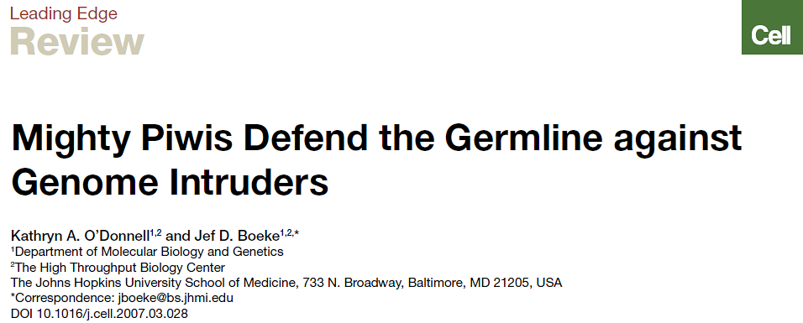
In recent years, Piwi proteins were recognized as having potential anti-mobile element activity.
Cell 129, April 6, 2007

Slide 39
GETHESEMANE ANSWERS:
Wages of sin is death—both First and Second (Romans 6:23).
What would have happened had God not intervened in Genesis 3:15, by putting “enmity between thy seed and her seed”.
Additional information needed for the cross???
He shall see of the travail of his soul, and shall be satisfied: by his knowledge shall my righteous servant justify many; for he shall bear their iniquities.
(Isaiah 53:11 AKJV)

Slide 40
THE CROSS

Slide 41
What do the Scriptures say about Christ’s death on the cross and its relevance to our salvation?
Therefore we were buried with Him by baptism into death, so that as Christ was raised up from the dead by the glory of the Father; even so we also should walk in newness of life. For if we have been joined together in the likeness of His death, we shall also be in the likeness of His resurrection;
(Romans 6:4-5)

Slide 42
Therefore as by the offense of one judgment came on all men to condemnation; even so by the righteousness of one the free gift came on all men to justification of life.
(Romans 5:18 AKJV)
For then must he often have suffered since the foundation of the world: but now once in the end of the world has he appeared to put away sin by the sacrifice of himself.
(Hebrews 9:26 AKJV)
Knowing this, that our old man is crucified with him, that the body of sin might be destroyed, that from now on we should not serve sin.
(Romans 6:4-6 AKJV)

Slide 43
Who being the brightness of his glory, and the express image of his person, and upholding all things by the word of his power, when he had by himself purged our sins, sat down on the right hand of the Majesty on high:
(Hebrews 1:3 AKJV)
By the which will we are sanctified through the offering of the body of Jesus Christ once for all.
(Hebrews 10:10 AKJV)

Slide 44
THE ONLY WAY THAT CHRIST COULD ABOLISH DEATH AND SUBSTITUTE IMMORTAL LIFE, AS WELL AS MAKE US PERFECT FOREVER, IS IF HE REMOVED THE MGE’S FROM THE HUMAN GENOME!
But is now made manifest by the appearing of our Savior Jesus Christ, who has abolished death, and has brought life and immortality to light through the gospel:
(2 Timothy 1:10 AKJV)

Slide 45
In whom also you are circumcised with the circumcision made without hands, in putting off the body of the sins of the flesh by the circumcision of Christ:
Buried with him in baptism, wherein also you are risen with him through the faith of the operation of God, who has raised him from the dead.
And you, being dead in your sins and the uncircumcision of your flesh, has he quickened together with him, having forgiven you all trespasses;
Blotting out the handwriting of ordinances that was against us, which was contrary to us, and took it out of the way, nailing it to his cross;
And having spoiled (wholly put off from oneself) principalities and powers, he made a show of them openly, triumphing over them in it. (Colossians 2:11-15 AKJV)

Slide 46
Handwriting of Ordinances
And it shall come to pass, when many evils and troubles are befallen them, that this song shall testify against them as a witness; for it shall not be forgotten out of the mouths of their seed: for I know their imagination which they go about, even now, before I have brought them into the land which I swore.
(Deuteronomy 31:21 AKJV)
That Moses commanded the Levites, which bore the ark of the covenant of the LORD, saying,
Take this book of the law, and put it in the side of the ark of the covenant of the LORD your God, that it may be there for a witness against you.
(Deuteronomy 31:25-26 AKJV)

Slide 47
“in putting off the body of the sins of the flesh by the circumcision of Christ”
And you shall circumcise the flesh of your foreskin; and it shall be a token of the covenant between me and you.
(Genesis 17:11 AKJV)
And the LORD your God will circumcise your heart, and the heart of your seed, to love the LORD your God with all your heart, and with all your soul, that you may live.
(Deuteronomy 30:6 AKJV)

Slide 48
And when a stranger shall sojourn with you, and will keep the passover to the LORD, let all his males be circumcised, and then let him come near and keep it; and he shall be as one that is born in the land: for no uncircumcised person shall eat thereof.
(Exodus 12:48 AKJV)

Slide 49
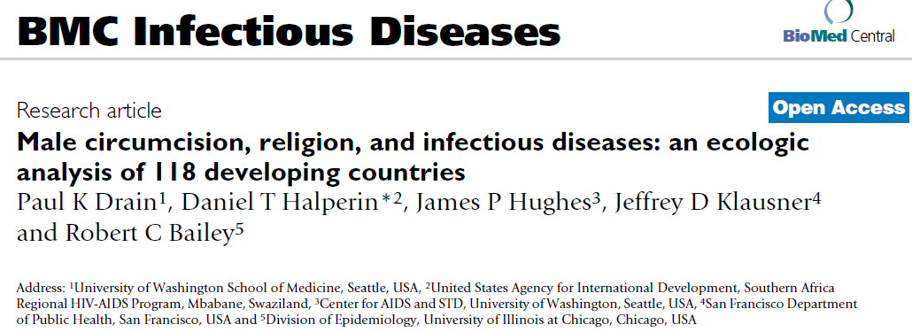
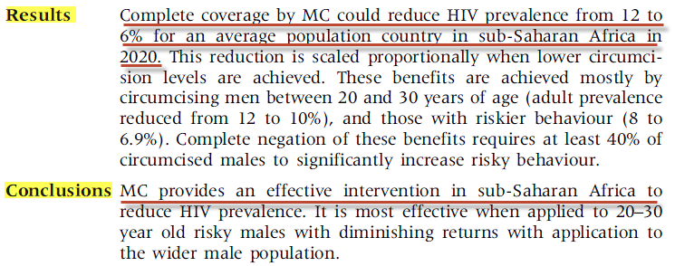

Slide 50
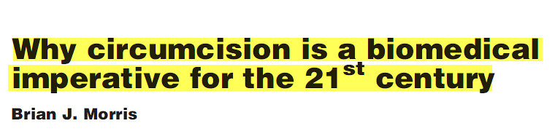
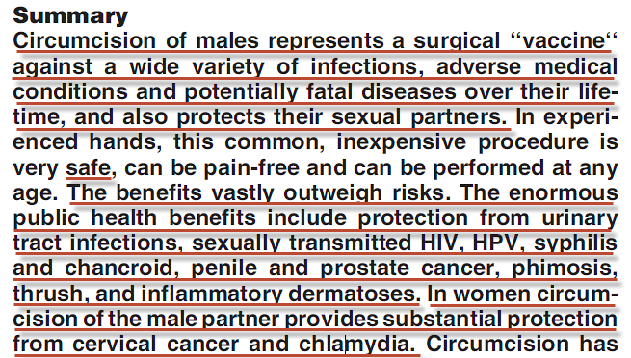
BioEssays 29:1147–1158, 2007

Slide 51
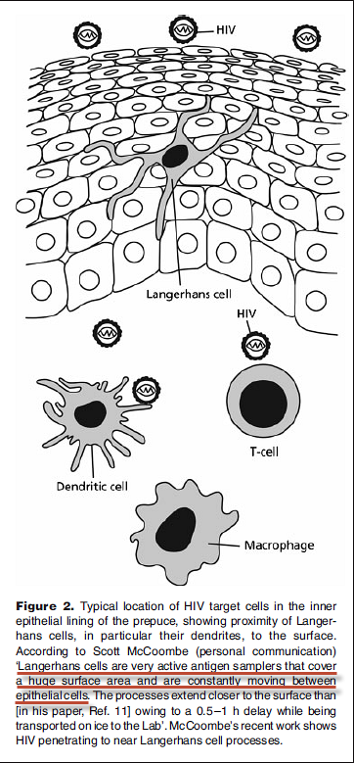
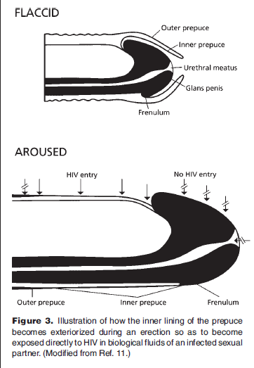
BioEssays 29:1147–1158, 2007

Slide 52
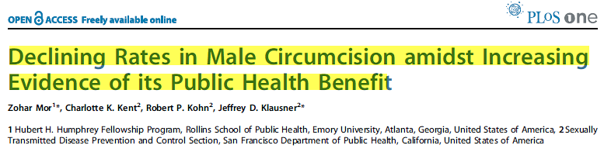
Therefore, circumcise the foreskin of your heart, and be no longer stiff-necked. (Deut. 10:16)
PLoS ONE - September 2007 | Issue 9 | e861
We continue to be a “stiff-necked” people. When will we learn?

Slide 53
EXACTLY WHAT HAPPENED ON THE CROSS TO “CIRCUMCISE” THE MGE’S? WE DO NOT KNOW….AND MAY NEVER UNDERSTAND WHAT HAPPENED!
The thieves also, which were crucified with him, cast the same in his teeth.
Now from the sixth hour there was darkness over all the land to the ninth hour.
(Matthew 27:44-45 AKJV)

Slide 54
Fig. 1 A correlation-based network connecting genes with similar genetic interaction profiles.
M Costanzo et al. Science 2010;327:425-431
Published by AAAS
Notes:
A correlation-based network connecting genes with similar genetic interaction profiles. Genetic profile similarities were measured for all gene pairs by computing Pearson correlation coefficients (PCCs) from the complete genetic interaction matrix. Gene pairs whose profile similarity exceeded a PCC > 0.2 threshold were connected in the network and laid out using an edge-weighted, spring-embedded, network layout algorithm (7, 8). Genes sharing similar patterns of genetic interactions are proximal to each other; less-similar genes are positioned farther apart. Colored regions indicate sets of genes enriched for GO biological processes summarized by the indicated terms.

Slide 55
Christ, on the cross, was treated by God as an unrepentant sinner. What was Christ’s cry to God as He was dying on the cross?
And about the ninth hour Jesus cried with a loud voice, saying, Eli, Eli, lama sabachthani? that is to say, My God, my God, why have you forsaken me?
(Matthew 27:46 AKJV)

Slide 56
Can we know that Christ was completely successful in the removal of the MGE’s?
In the end of the sabbath, as it began to dawn toward the first day of the week, came Mary Magdalene and the other Mary to see the sepulcher.
And, behold, there was a great earthquake: for the angel of the Lord descended from heaven, and came and rolled back the stone from the door, and sat on it.
His countenance was like lightning, and his raiment white as snow:
And for fear of him the keepers did shake, and became as dead men.
(Matthew 28:1-4 AKJV)

Slide 57
Which in his times he shall shew, who is the blessed and only Potentate, the King of kings, and Lord of lords; Who only hath immortality, dwelling in the light which no man can approach unto; whom no man hath seen, nor can see: to whom be honour and power everlasting. Amen.
(1Timothy 6:15-16)

Slide 58
And if Christ be not raised, your faith is vain; you are yet in your sins.
Then they also which are fallen asleep in Christ are perished.
(1 Corinthians 15:17-18 AKJV)

Slide 59
Jesus Christ the same yesterday, and to day, and for ever. (Hebrews 13:8 AKJV)
But now is Christ risen from the dead, and become the firstfruits of them that slept.
(1Corinthians 15:20)

